Slide 1
Intent Contrastive Learning with Cross Subsequences for Sequential Recommendation
WSDM 2024
Reported by liang li

Slide 2
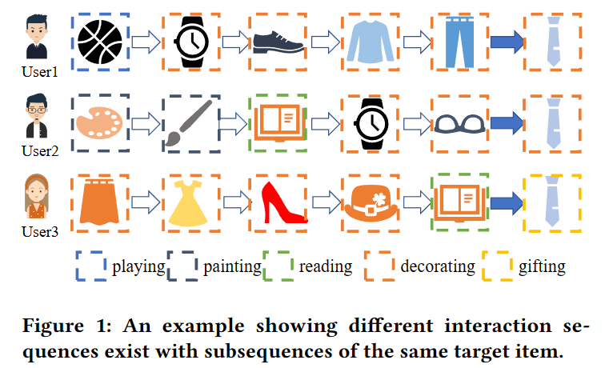
Motivation
Details：
They usually model each user interaction sequence individually and thus ignore the correlation between users with similar subsequence patterns.
The intention to buy the same item in different contexts may be different.

Slide 3
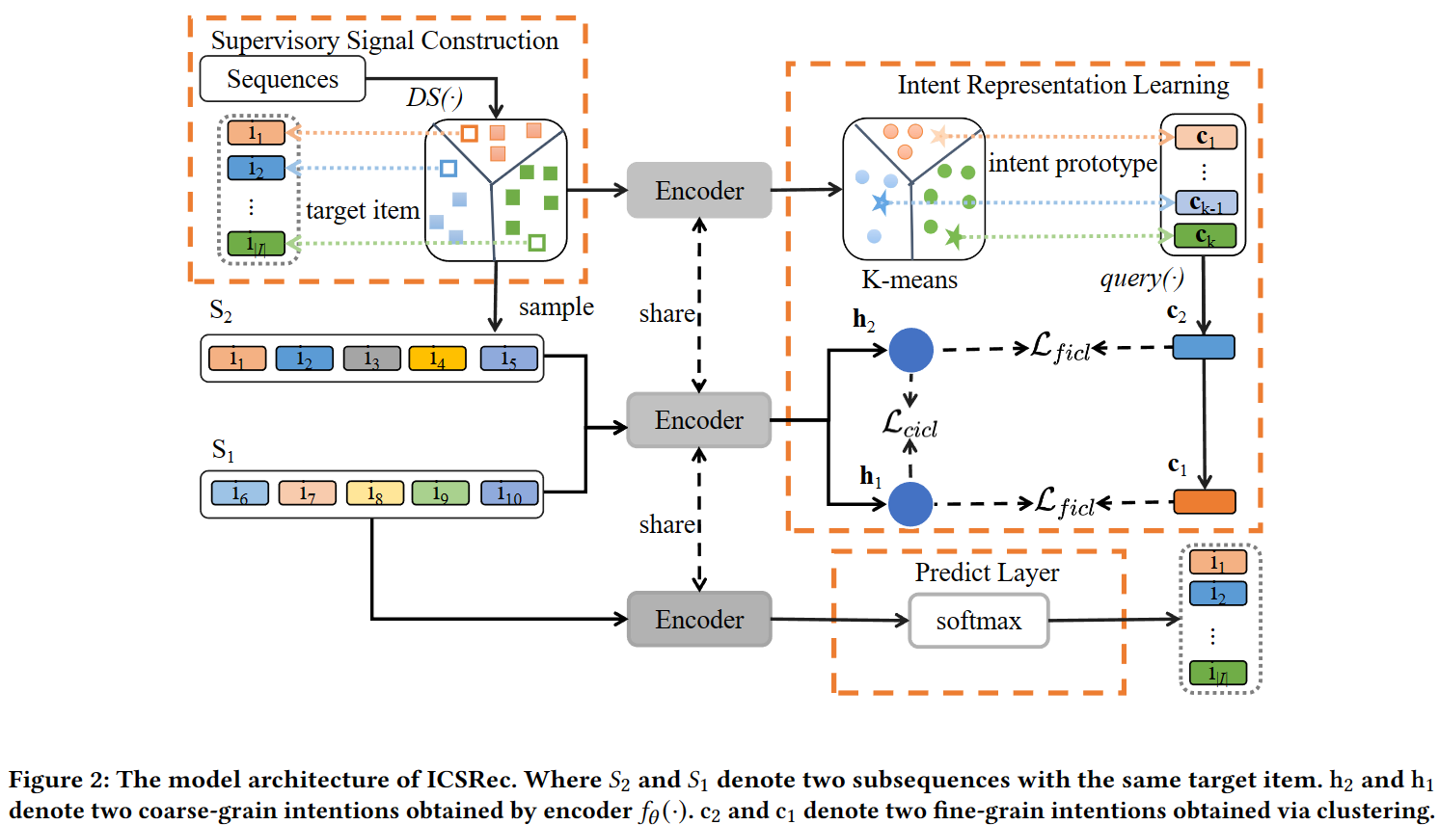
Problem Statement

Slide 4
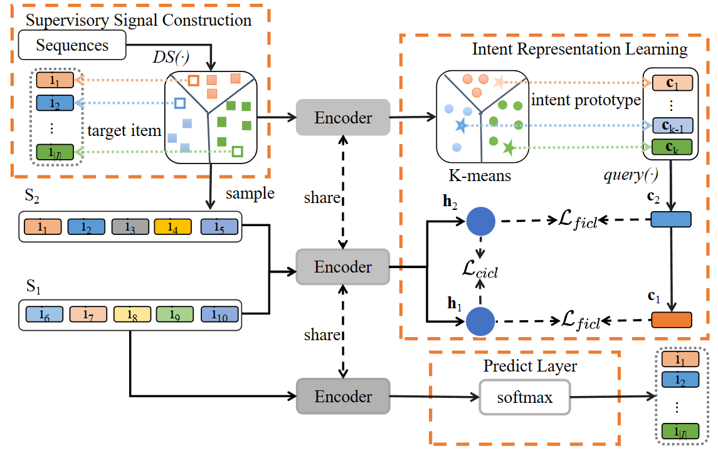
Method

Slide 5
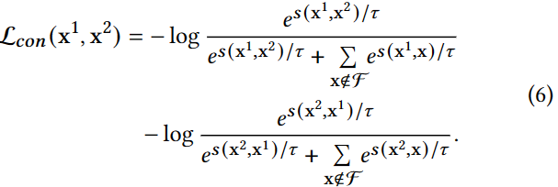
Method

Slide 6
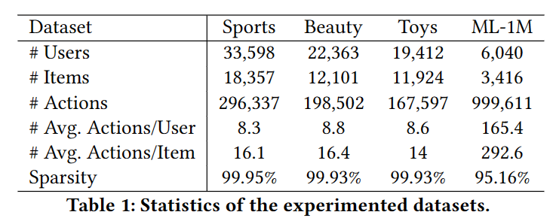
Experiments

Slide 7
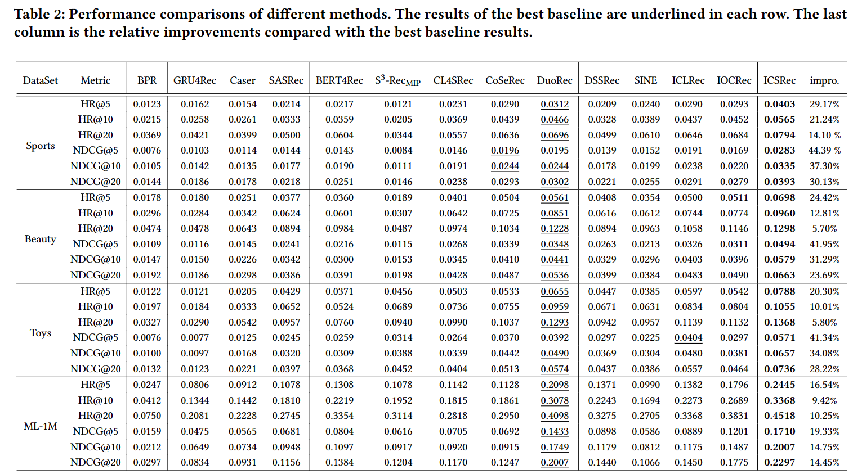
Experiments

Slide 8
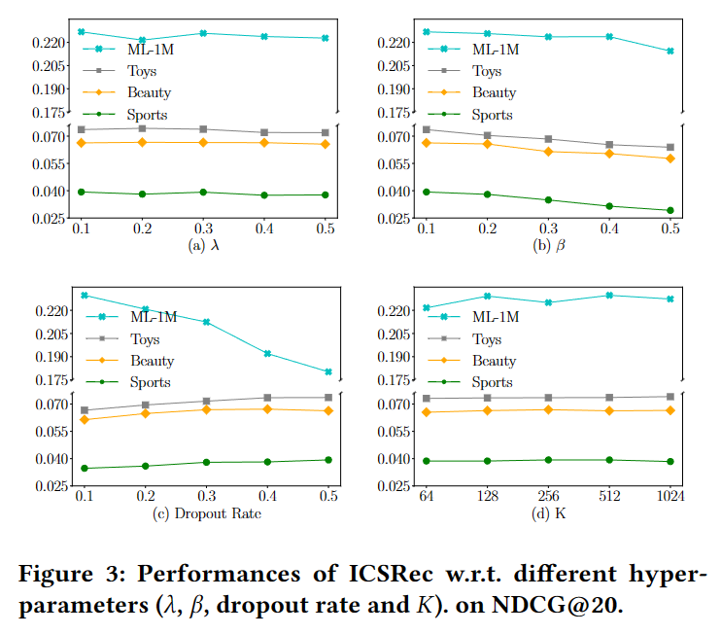
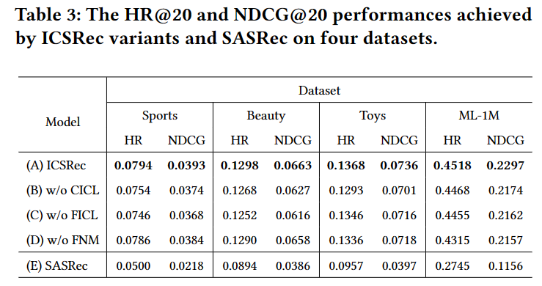
Experiments

Slide 9
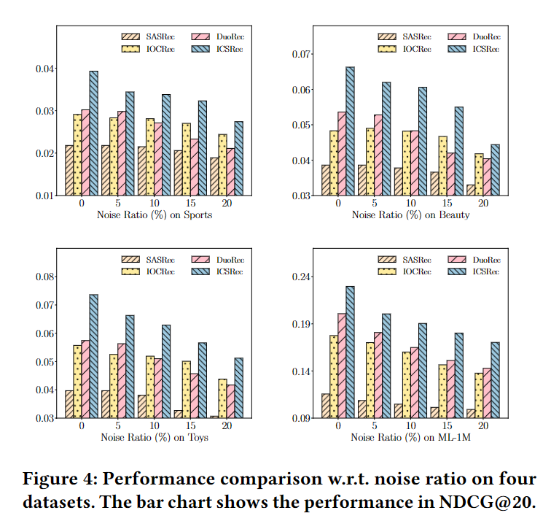
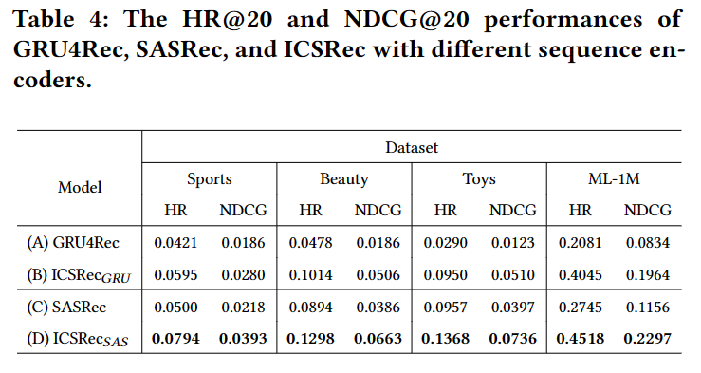
Experiments

Slide 10
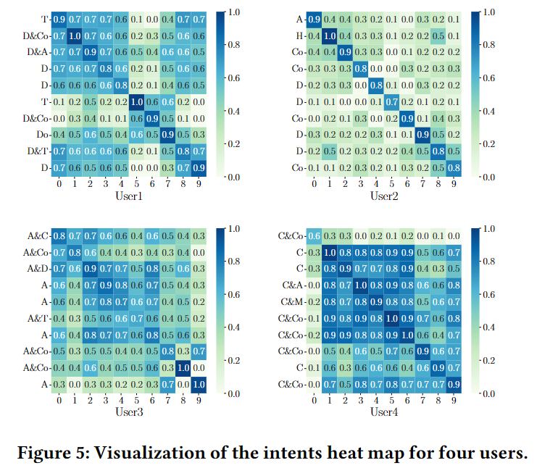

Slide 11
Thanks

